Slide 1
Algorithms Parallelization in ASIC Design
Relatori:
Prof. Mariagrazia Graziano
Prof. Marco Vacca
Prof. Maurizio Zambon
Candidato:
Jiang Gina

Slide 2
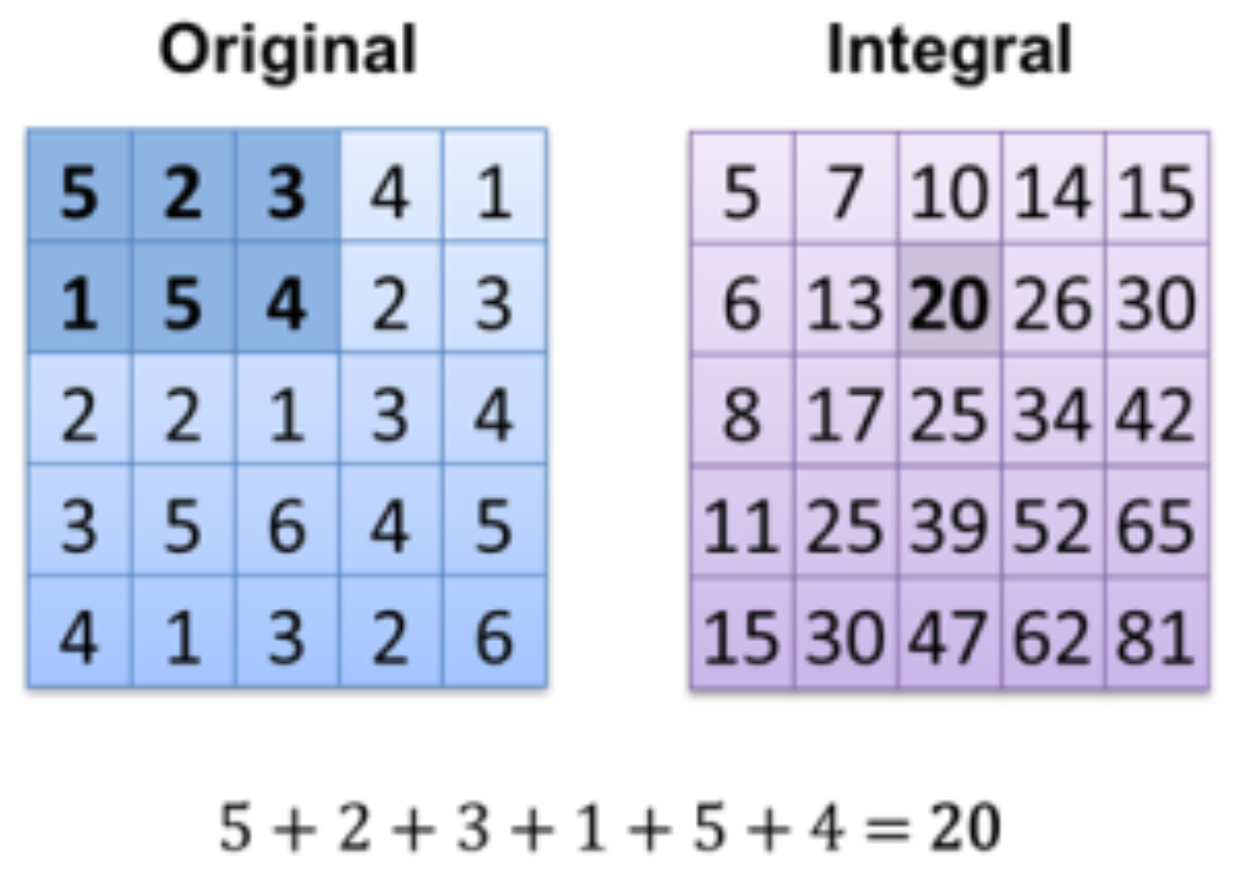
SUMMED AREA TABLE
Is an algorithm for quickly and eﬃciently generating the sum of values in a rectangular subset of a grid.

Slide 3
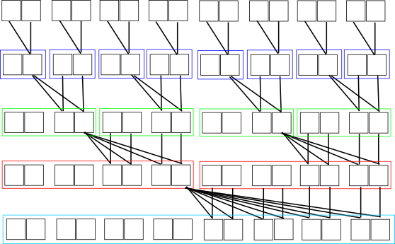
SUMMED AREA TABLE -1D Method used
16 elements
1st cycle
2nd cycle
3rd cycle
4th cycle

Slide 4
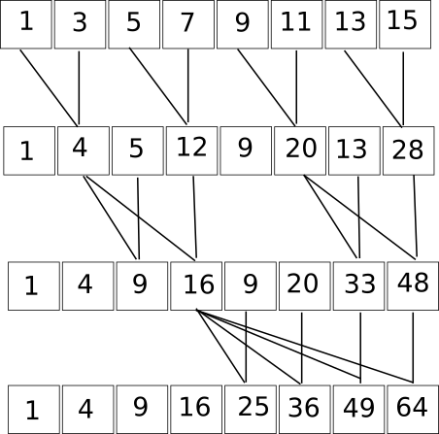
SUMMED AREA TABLE -1D Ex. First 8 odd numbers

Slide 5
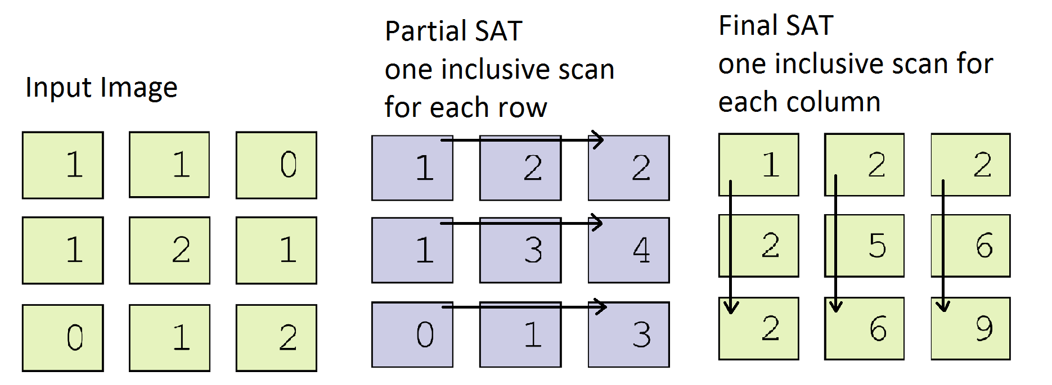
SUMMED AREA TABLE -1D Inclusive scan

Slide 6
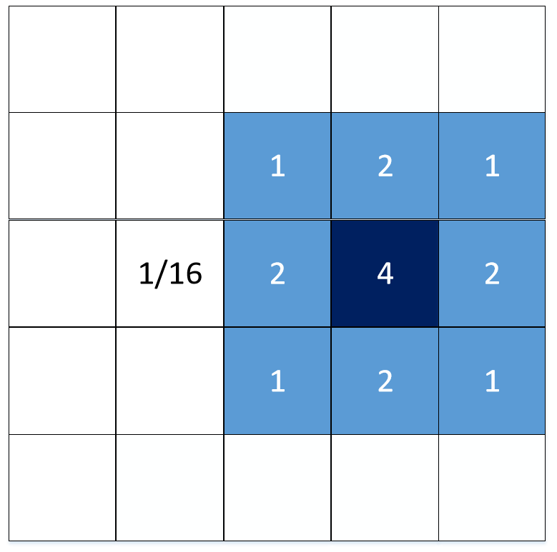
Binomial Filter
It’s a weighted mean using binomial coefficients between the cell with the neighborhood.

Slide 7
Binomial Filter Optimization
Usually you would compute the Binomial Filter for each cells, which requires 5

